Slide 1
Computer Science Club
Brought by the club leadership: Matt Jin, Reid Sendroff & Max Bergman

Slide 2
Goals
Compete in International and National Contests this year
Learn Competitive Programming
Build Teamwork and Problem solving skills
Grow as programmers
Prepare for future competitions
Build Projects
Learn Programming

Slide 3
Why Computer Science Club?
Beginner Friendly
Advance Friendly
Casual and Serious commitment welcome
Opportunities for Leading the club
Work on real-world coding challenges
Opportunity to learn advanced problem-solving beyond school
Compete in engaging contests

Slide 4
Benefits of participation in the Computer Science Club
Improve critical thinking and algorithms skills through lectures/workshops
Stand out on college applications
Access to resources, mentorship, and prep sessions
Networking: meet students interested in tech/CS
Earn Leadership positions
Win Awards in prestigious competitions

Slide 5
Fall & Winter Contests
PClassic (UPenn) — Fall edition — semesterly HS programming contest (TBD)
CALICO (UC Berkeley) — Fall edition — biannual HS team contest; (November)
UCF HSPT — Online edition (December)
Bebras Computing Challenge (November)
Advent Of Code (Fall online rounds)
MIT Informatics Contest Winter Round
American Computer Science League (ACSL) contests #1/#2/#3
Meta Hacker Cup (Practice Round starts place 10/7 (TOMORROW) and ends on 10/17

Slide 6
Spring Contests
Cornell HS Programming Workshop & Contest (March-April)
CALICO (UC Berkeley) — Spring edition (April)
PClassic (UPenn) — Spring edition (April)
CMIMC — Programming Division (Carnegie Mellon University) (April)
UCLA CodeSprint LA (April)
Stanford ProCo (March-April)
St. Joseph’s University (Long Island) High School Programming Competition
NJIT High School Programming Contest (March-April)
Lockheed Martin Code Quest (March April)
TechGig Code Gladiators (March-April)
MIT Informatics Contest Spring Round
American Computer Science League (ACSL) contests #4

Slide 7
Recurring Contests
Leetcode Contests (Weekly and Biweekly, 1 or 2 contests per week)
Codeforces Rounds (around 5-10 contests every two weeks)
AtCoder Competitions (Happens On weekends)
CodeChef (5-10 rated contests per month)
HackerRank (Monthly contests)
TopCoder Contests ()
Kattis Contests (Around 5-10 contests every month)

Slide 8
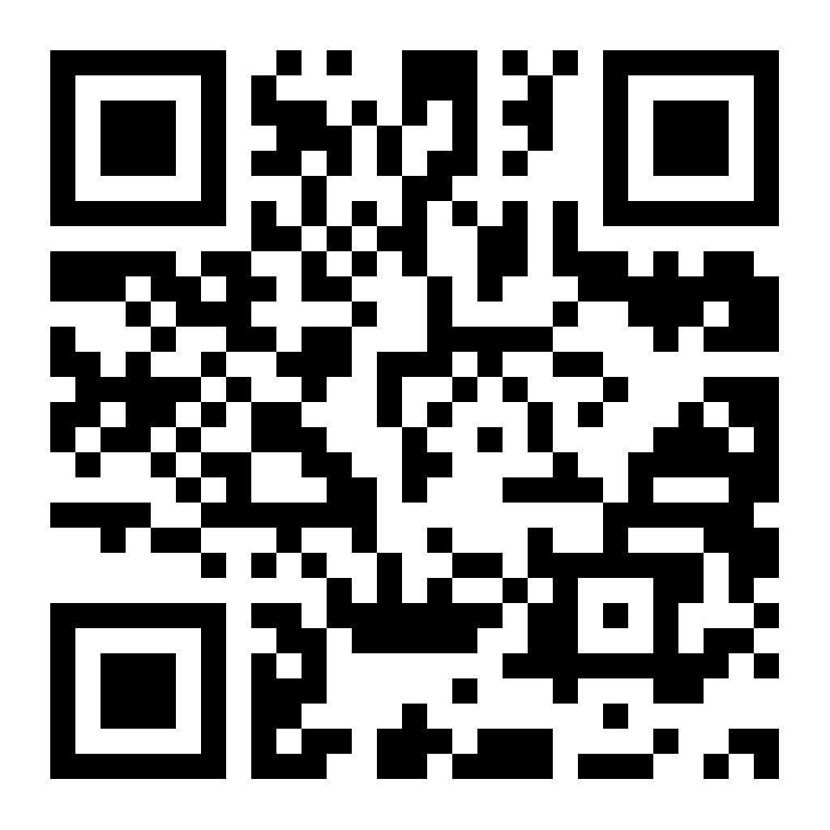
Interest form:
If you have not already done so, please respond to this google form to express your interest in the Computer Science Club this year!

Slide 9
Next Meeting’s Coding Challenge
How it works:
There will be 15 problems ranging from basic coding challenges to problems involving data structures and algorithms, to

